Slide 1



Walmart
WALMART SALES ANALYSIS
By Mandeep Sharma
Video Presentation Link
mandeep04sharma@gmail.com

Slide 2

introduction
Walmart operates in multiple cities with a diverse range of customers.
The dataset contains sales transactions, customer details, and product information.
Objective: Use SQL to analyze trends, customer behavior, and business performance.

Slide 3

Business problems
Walmart aims to optimize sales strategies by analyzing historical data.
Focus on sales growth, customer segmentation, product profitability, and payment preferences.
Approach: Using SQL queries to extract insights from sales transactions.

Slide 4

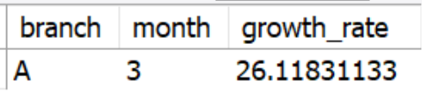
WITH monthly_sales AS (
SELECT
branch,
MONTH(date) AS month,
SUM(total) AS total_sales
FROM sales
GROUP BY branch, MONTH(date)
),
sales_growth AS (
SELECT
m1.branch,
m1.month,
m1.total_sales AS current_month_sales,
m2.total_sales AS previous_month_sales,
((m1.total_sales - m2.total_sales) / m2.total_sales) * 100 AS growth_rate
FROM monthly_sales m1
LEFT JOIN monthly_sales m2
ON m1.branch = m2.branch
AND m1.month = m2.month + 1
WHERE m2.total_sales IS NOT NULL
)
SELECT branch, month, growth_rate
FROM sales_growth
ORDER BY growth_rate DESC
LIMIT 1;
IDENTIFYING THE TOP BRANCH BY SALES GROWTH RATE
branch ‘A’ showed the highest
sales growth in March

Slide 5
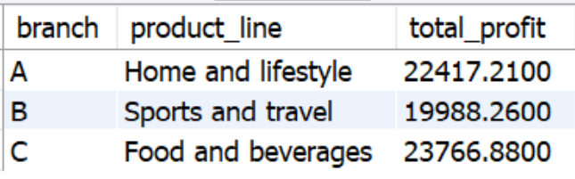
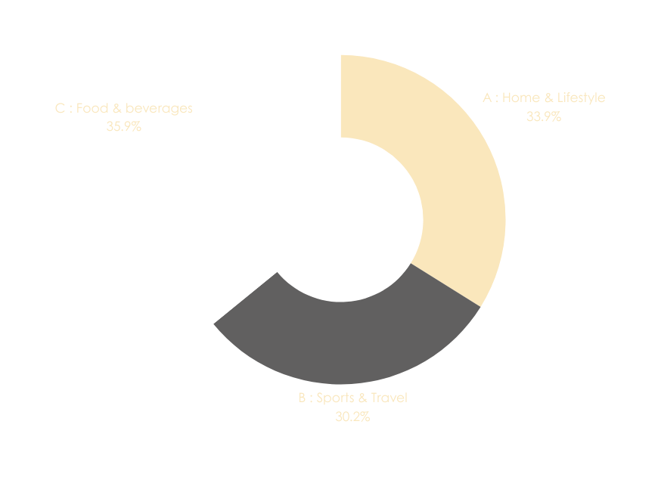
2. Most Profitable Product Line Per Branch
WITH ranked_products AS (
SELECT
branch,
product_line,
SUM(total) AS total_profit,
RANK() OVER (PARTITION BY branch ORDER BY SUM(total) DESC) AS rnk
FROM sales
GROUP BY branch, product_line
)
SELECT branch, product_line, total_profit
FROM ranked_products
WHERE rnk = 1;

Slide 6
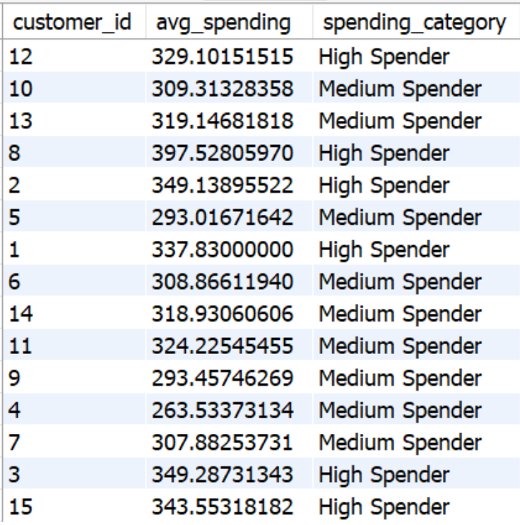
3. Customer Segmentation Based on Spending
SELECT
customer_id,
AVG(total) AS avg_spending,
CASE
WHEN AVG(total) > 325 THEN 'High Spender'
WHEN AVG(total) BETWEEN 200 AND 325 THEN 'Medium Spender'
ELSE 'Low Spender'
END AS spending_category
FROM sales
GROUP BY customer_id;

Slide 7
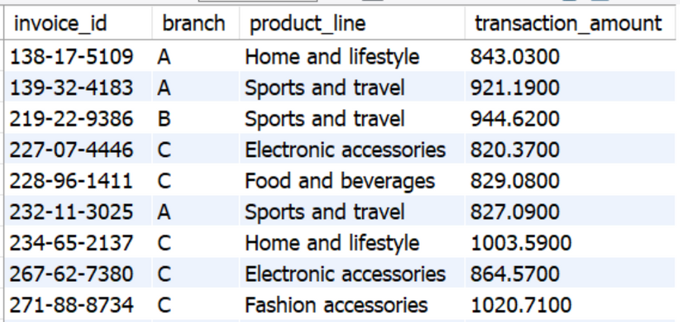
4. ANOMALY DETECTION IN SALES
SELECT invoice_id, product_line, total
FROM sales
WHERE total > (SELECT AVG(total) + 2 * STDDEV(total) FROM sales)
OR total < (SELECT AVG(total) - 2 * STDDEV(total) FROM sales);

Slide 8
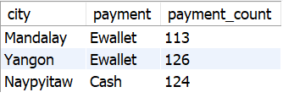
5. MOST POPULAR PAYMENT METHOD BY CITY
Ewallet is most popular payment method
WITH payment_rank AS (
SELECT city, payment, COUNT(*) AS payment_count,
RANK() OVER (PARTITION BY city ORDER BY COUNT(*) DESC) AS rnk
FROM sales
GROUP BY city, payment
)
SELECT city, payment, payment_count
FROM payment_rank
WHERE rnk = 1;

Slide 9

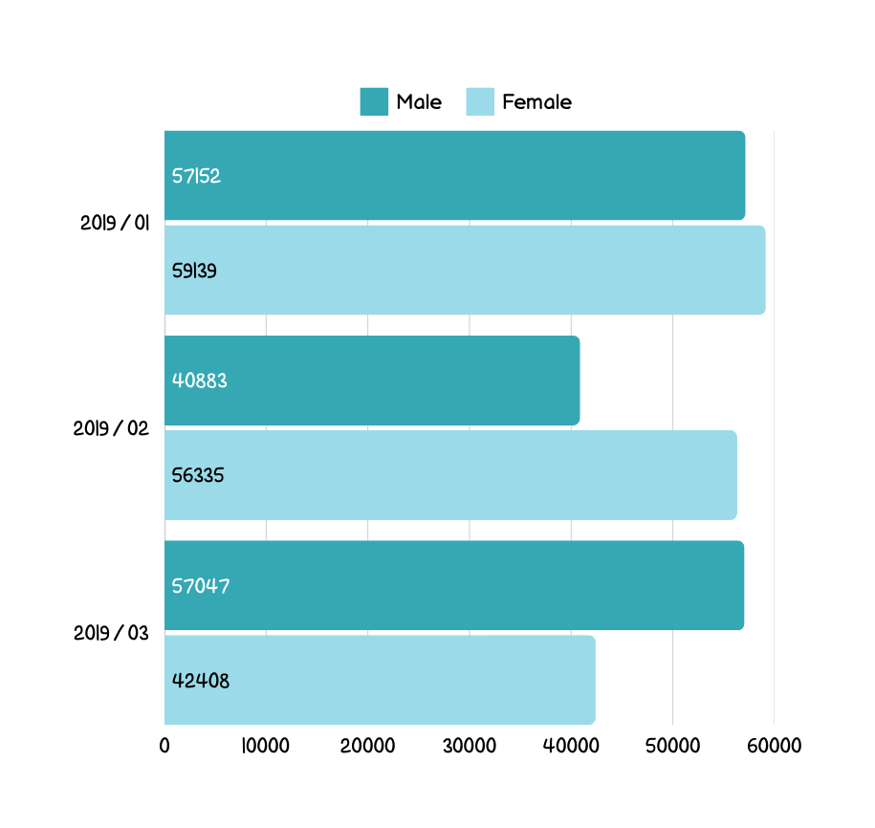
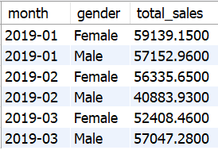
6. Monthly Sales Distribution by Gender
SELECT
DATE_FORMAT(date, '%Y-%m') AS month,
gender,
SUM(total) AS total_sales
FROM sales
GROUP BY month, gender
ORDER BY month, gender;

Slide 10
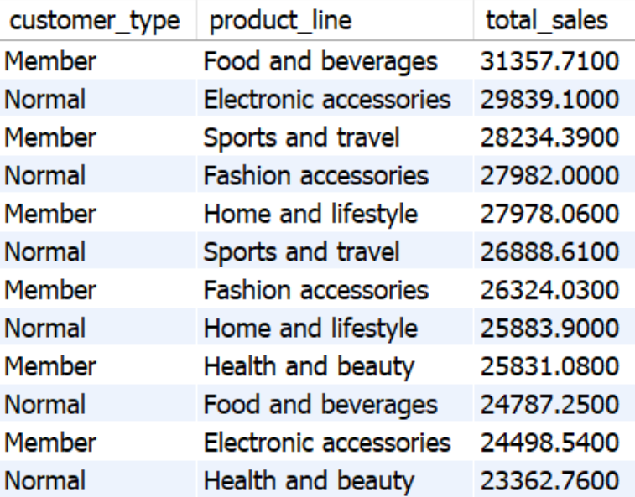
7.BEST PRODUCT LINE BY CUSTOMER TYPE
SELECT
customer_type,
product_line,
SUM(total) AS total_sales
FROM sales
GROUP BY customer_type, product_line
ORDER BY total_sales DESC;

Slide 11
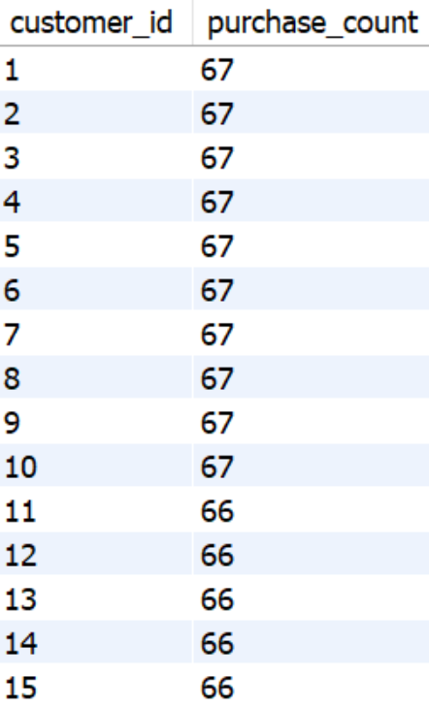
8. IDENTIFYING REPEAT CUSTOMERS
IN LAST 30 DAYS
SELECT customer_id, COUNT(*) AS purchase_count
FROM sales
WHERE date >= DATE_SUB(date, INTERVAL 30 DAY)
GROUP BY customer_id
HAVING purchase_count > 1;
100% of customers made repeat purchases within 30 days.

Slide 12

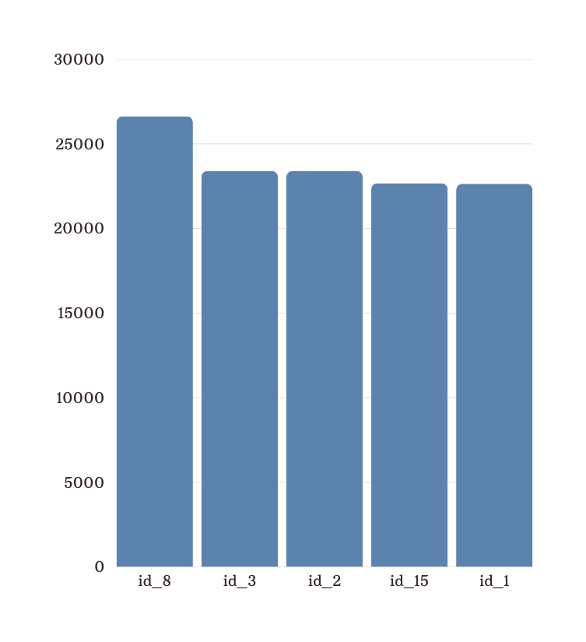
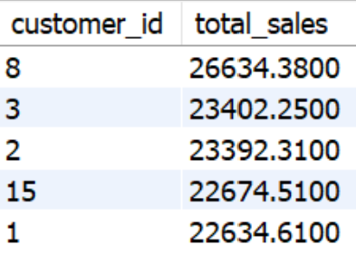
9.Top 5 Customers
by Sales Volume
SELECT customer_id, SUM(total) AS total_sales
FROM sales
GROUP BY customer_id
ORDER BY total_sales DESC
LIMIT 5;

Slide 13


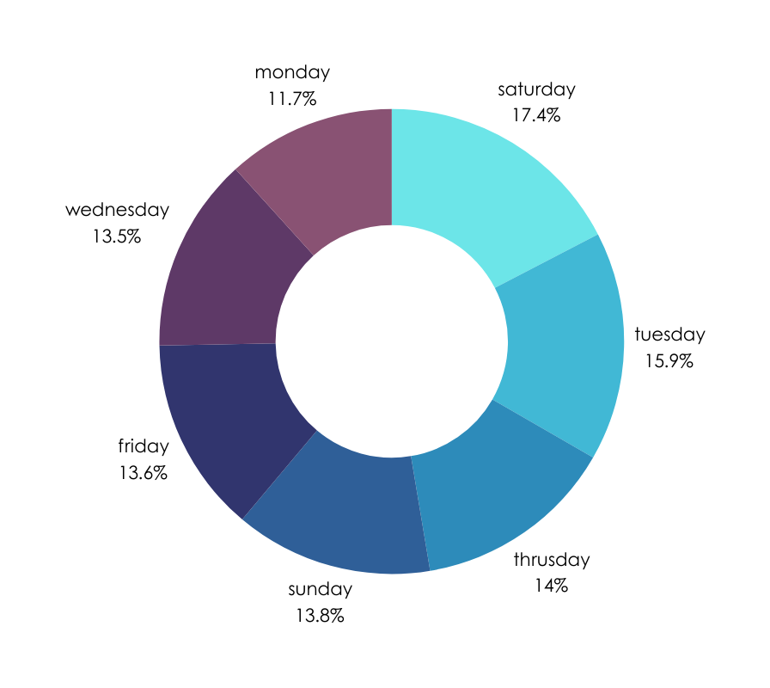
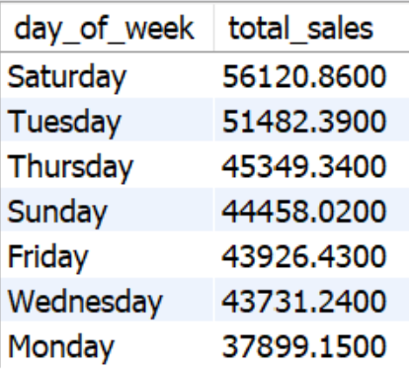
10. : Analyzing Sales Trends
by Day of the Week
SELECT
DAYNAME(date) AS day_of_week,
SUM(total) AS total_sales
FROM sales
GROUP BY day_of_week
ORDER BY total_sales DESC;

Slide 14
Sales Performance Analysis
🏆 Top Growth Branch
✅ Branch A leads with a 📈 26.11% sales growth rate.
💰 Most Profitable Product Lines (by Branch)
🔹 Branch A – Home & Lifestyle (₹22,417)
🔹 Branch B – Sports & Travel (₹19,988)
🔹 Branch C – Food & Beverages (₹23,766)
👑 High-Value Customers
✅ Customer ID 12 has the highest average spend of ₹329.1.
⚠️ Sales Anomalies
✅ Identified unusually high & low transactions, indicating potential pricing errors or fraud risks.

Slide 15
CUSTOMER & PAYMENT TRENDS
💳 Most Popular Payment Method
✅ E-Wallets dominate in Mandalay with 133 transactions.
📆 Monthly Sales by Gender
✅ Clear male vs. female spending trends – visualized through charts & insights.
🛍️ Best Product Line (by Customer Type)
✅ Normal Customers prefer Food & Beverages the most.
🔄 Repeat Customers
✅ 100% customer retention within 30 days – strong loyalty but a need for new customer acquisition.
🏅 Top 5 Customers by Sales Volume
1️⃣ Customer ID 8 – ₹26,634
2️⃣ Customer ID 3 – ₹23,402
3️⃣ Customer ID 2 – ₹23,392
4️⃣ Customer ID 15 – ₹22,674
5️⃣ Customer ID 1 – ₹22,634

Slide 16
Recommendations
📌 Boost marketing & promotions on Saturdays to
maximize revenue.
📌 Prioritize Home & Lifestyle products in Branch A for
higher profitability.
📌 Offer loyalty rewards & exclusive deals to top
customers to increase retention.
📌 Enhance digital payment campaigns, as e-wallets are
the preferred payment method.

Slide 17

That was Walmart Analysis using Sql
THANK YOU
By Mandeep Sharma
Video Presentation Link
mandeep04sharma@gmail.com
+91 99965 95342

